Slide 1
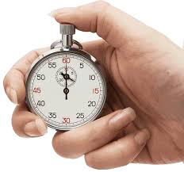
NCSC SPEED SELLING – Coaches & Students
What is SPEED SELLING?
90 second (max) Elevator Speech to select NCSC Sponsors:
Product, Platinum, and Silver Sponsors (see following slides for participants)
Who’s Eligible?
Students not competing in NCSC Role-Play Competition. Limit: 10 students from each university.
Must register for NCSC Career Fair.
All speed selling competitors are required to schedule an appointment with the sponsor prior to the event.
Each student may sign up for a MAXIMUM OF THREE speed selling appointments.
Appointment sign up links will be distributed at noon on Friday, February 16th
The Rules:
The objective is to get an appointment for a job or internship interview.
The speech must include: (see NCSC Judging Form next page)
Professional Introduction
Gain Attention
Knowledge of Judging Company
Attempt to gain commitment to next step of hiring process (job or internship)
Effective communication and professionalism
Be non-scripted and conversational
Other (Can be creative)
STUDENTS CAN PRESENT ONLY ONCE PER COMPANY—NO REDO’s.
Speed Selling Judging Sponsors will be identified by a yellow vest.
Speed Selling Competitors should identify themselves to the Judging Sponsor.
90 seconds or less time limit.
Sponsors will have judging forms (see NCSC Judging Form on the next page)
Speed Selling is ONE round only. The top Speed Seller for each sponsor will win a $100 gift card. Competitors may win multiple times. Winners will be announced on Sunday night!
Good luck and good selling!
Saturday 3/9: 11am – 4pm
During NCSC Career Fair

Slide 2
NCSC SPEED SELLING – Sponsor Judging Companies
ALL COMPETITORS MUST SCHEDULE A SPEED SELLING APPOINTMENT PRIOR TO THE COMPETITION
THE SIGNUP LINKS WILL BE DISTRIBUTED ON FRIDAY, FEBRUARY 16th

Slide 3
NCSC SPEED SELLING – Sponsor Judging Companies
ALL COMPETITORS MUST SCHEDULE A SPEED SELLING APPOINTMENT PRIOR TO THE COMPETITION
STUDENTS MAY SIGN UP FOR A MAXIMUM OF THREE COMPANIES
 | Schedule via online calendar using the following link: https://www.signupgenius.com/go/10C0D4FAEAC22A4F4CF8-47950650-speed
 | Schedule via online calendar using the following link: https://www.signupgenius.com/go/10C0D4FAEAC22A4F4CF8-47950852-speed
 | Schedule via online calendar using the following link: https://www.signupgenius.com/go/10C0D4FAEAC22A4F4CF8-47950894-speed
 | Schedule via online calendar using the following link: https://www.signupgenius.com/go/10C0D4FAEAC22A4F4CF8-47950891-speed
 | Schedule via online calendar using the following link: https://www.signupgenius.com/go/10C0D4FAEAC22A4F4CF8-47950858-speed
 | Schedule via online calendar using the following link: https://www.signupgenius.com/go/10C0D4FAEAC22A4F4CF8-47950848-speed
 | COMING SOON!
Processor Division
Distribution Division

Slide 4
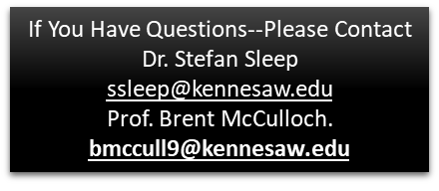
NCSC SPEED SELLING – Coaches & Competitors
SPEED SELLING Judging Form
Please Print all information
Student Name:
University:
Date of Graduation:
Judging Company Name:
Judging Company Representative: filled out by judge
ELEVATOR SPEECH CONTENT Objective: Gain follow-up meeting for job or internship interview | 0-10
Candidate Introduction
Attention Getting Statement
Knowledge of company (Speed-Selling judging sponsor)
Effectiveness of Attempt to Gain Commitment to next step in hiring process
Communication & Professionalism
Non-Scripted and Conversational
Professionalism and confidence
Total Score
FEEDBACK NOTES/OBSERVATIONS:

